Slide 1

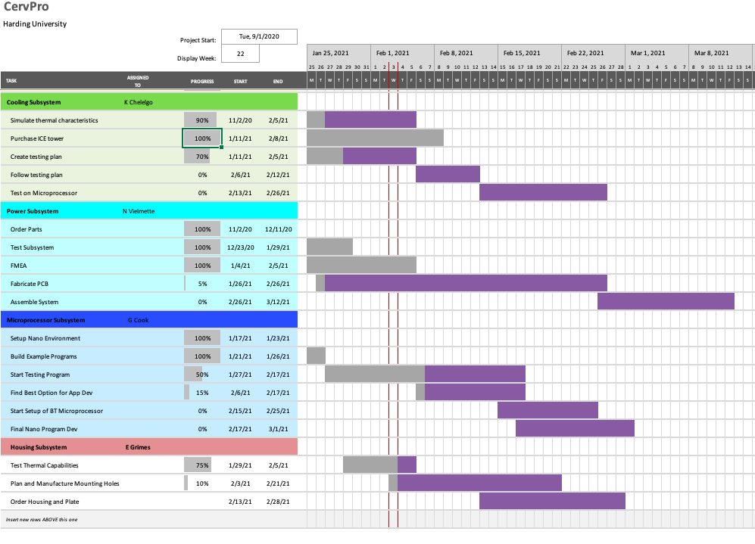
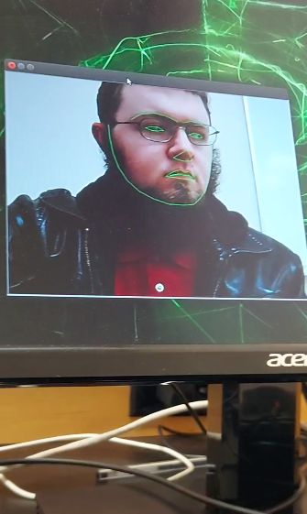

CervPro
Cervical Proprioception Diagnosis: A3 Status
Date: February 4, 2021
Members: Nathan Vielmette, Ethan Grimes, Keneth Chelelgo, and George Cook
Background
PT cervical proprioception (CP) assessments are subjective and determined by PT opinion.
Motivation is to create device that gives PTs objective data that shows patients’ ability to sense head and neck position in space.
Device will sense head position and angular velocity.
Proposed Countermeasures
Dedicate weekend to project lab
A preprocessing algorithm to increase exposure/contrast
Provide a light with the camera to illuminate the face
Follow microchips instructions on how to write a Bluetooth enabled app
Create manufacturing plan for drilling fastener holes in aluminum plate
Current Conditions
Testing either begun or finished
in 2/3 subsystems
A little behind on PCB construction
Recent Results
Met with Dr. Wood regarding IP protections
Reviewed multisim model, created ultiboard project, and modelled packaging/footprint for PCB-mounted components
Reviewed available overcurrent protection, chose in-line fuse
Algorithm is up and running, being tested currently
Algorithm can track rotation 80º left and 70º right
ICE microprocessor cooling tower ordered
SK-19 Polycarbonate housing chosen
Goals/Targets
Use of device will be faster than double standard CPE test time ~10 min
Patient will not need to touch any part of device
Accurately measures head position and speed within 5% error margin
Device will be move and <10lbs
Next Steps
Machine PCB (Nathan)
Compare a preprocessing algorithm to a light to see which is best (George)
Learn to make Bluetooth app and start development (George)
Continue testing of facial recognition algorithm (George)
Begin testing ICE cooling tower once it arrives (Keneth)
Go to the Ulrey to refresh manufacturing skills, decide on suitable fastener(s) for internal components (Ethan)
Analysis
Plotting PCB with Protomat
Facial algorithm is not working on dark faces
No knowledge on how to interact with Bluetooth model on mobile devices
Housing fasteners and internal plate machining technique for components undecided

Slide 2
CervPro
Cervical Proprioception Diagnosis: A3 Status
Date: February 4, 2021
Members: Nathan Vielmette, Ethan Grimes, Keneth Chelelgo, and George Cook

Slide 3

CervPro
Cervical Proprioception Diagnosis: A3 Status
Date: February 4, 2021
Members: Nathan Vielmette, Ethan Grimes, Keneth Chelelgo, and George Cook

